Slide 1
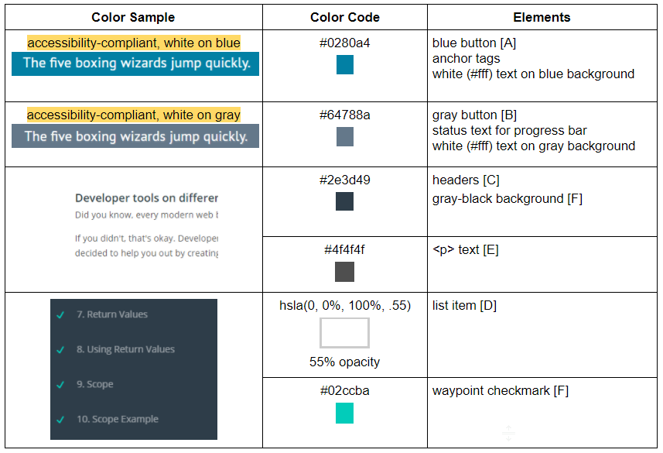
Study Buddies Color Glossary

Slide 2
The Research and Analysis

Slide 3
Color Analysis
Process followed: * Collect color values from Udacity Classroom
* Analyze color combinations to get contrast ratio (color contrast analysis tools)
* Determine if contrast ratio complies with WCAG minimum guideline
If yes, keep Udacity color value
If no, find a new color value that satisfies the guideline
Contrast is measured using a formula that gives a ratio ranging from 1:1 (no contrast: white text on white background or black text on black background) to 21:1 (maximum contrast: black text on white background or white text on black background).
@Sravanthi and @JaniceM discovered that, in 3 cases, the Udacity color combinations did NOT meet the minimum guideline for web accessibility.
The Study Buddies project will use color values that satisfy the WCAG Guidelines.

Slide 4

https://webaim.org/resources/contrastchecker/ (general purpose checker)
http://leaverou.github.io/contrast-ratio/ (to evaluate colors with opacity)
Contrast ratio is a value generated by comparing foreground (text or graphics) color to background color. It’s important to have sufficient contrast between foreground and background for many reasons:
create a better experience for users with color-deficient vision
content is legible in different lighting conditions, such as bright sunlight
content is easier to read by every site user
to avoid lawsuits and/or bad press
Web Content Accessibility Guidelines (WCAG) 2.0, level AA require a contrast ratio of:
at least 3.0:1 for large text*
at least 4.5:1 for non-large text
*Large text:
bold - 14 point (~18.66px) or larger
non-bold - 18 point (~24px) or larger
Udacity Color Combination |  |  | Contrast ratio calculated by WebAIM contrast checker tool | Does this comply with WCAG Guideline? | Study Buddies NEW color | Resulting Study Buddies contrast ratio
[A] | #fff | #02b3e4 | 2.45:1 | NO | #0280a4 | 4.54:1
[B] | #fff | #7d97ad | 3.04:1 | NO (fails non-large) | #64788a | 4.57:1
[C] | #fff | #2e3d49 | 11.17:1 | Yes | -- | --
[D] | hsla(0, 0%, 100%, .5) | #2e3d49 | 4.10:1 | NO (fails non-large) | hsla(0, 0%, 100%, .55) | 4.60:1
[E] | #fff | #4f4f4f | 8.19:1 | Yes | -- | --
[F] | #02ccba | #2e3d49 | 5.51:1 | Yes | -- | --

Slide 5



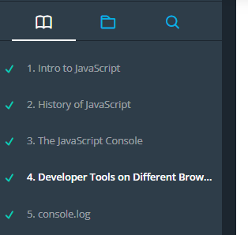
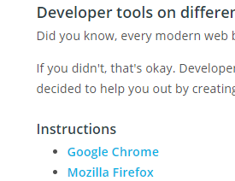
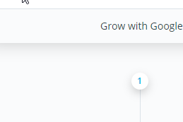

blue button #02b3e4 (same as <a>)
there’s a drop shadow
blue button:hover #028bb1
drop shadow changes on hover
text #fff
grey button #7d97ad
there’s a drop shadow
grey button:hover #607e97
drop shadow changes on hover
text #fff
progress bar #15c26b status text #7d97ad
icon #02b3e4 icon:hover + :active #fff
text hsla(0, 0%, 100%, .5)
text:hover #fff
text:active #fff, weight 400
checkmark #02ccba
gray-black background #2e3d49
black border #1c262f
headers #2e3d49
<p> text #4f4f4f
<a> #02b3e4 (same as blue button)
a:hover #2e3d49
slider #5d7385
Udacity Classroom Colors
A
B
B
D
F
C
E
light-gray background #fafbfc
“Open Sans”, Helvetica, sans-serif

